Slide 1
Ethics in AI Final Proj
Kyle Sanchez, Ian Wasson, & Will McIntosh

Slide 2
Find the Fake!
We’re about to show you paintings, two paintings for each artist. You tell us which one is generated by MidJourney and which is authentic from the painter?
Use the Zoom chat!
Answer quickly!
Ready….?

Slide 3
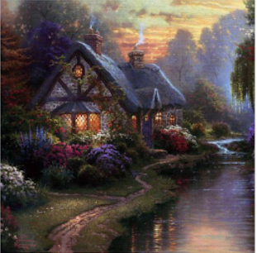
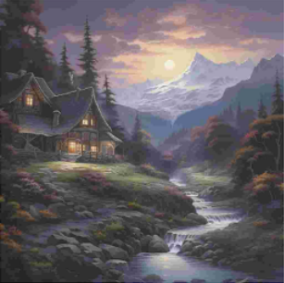
Find the Fake! (Kinkade) [1/3]
Picture A
Picture B

Slide 4
Find the Fake! (Kinkade) [1/3]
Fake!
Picture B

Slide 5
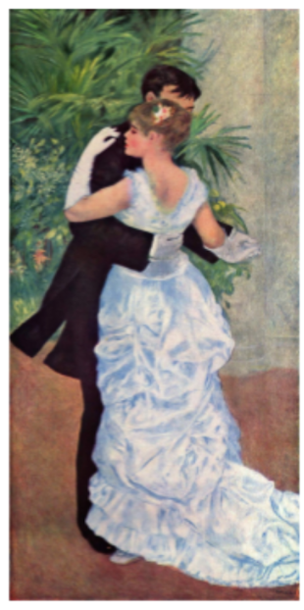
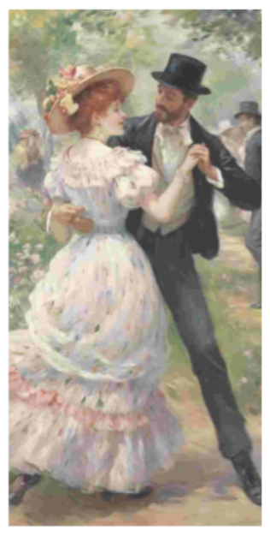
Find the Fake! (Renoir) [2/3]
Picture A
Picture B

Slide 6
Find the Fake! (Renior) [2/3]
Fake!
Picture B

Slide 7
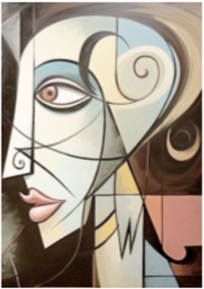
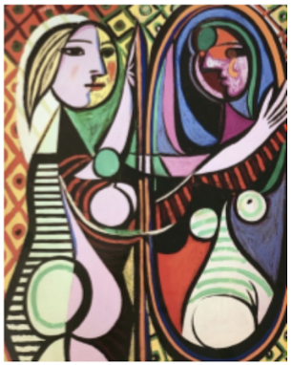
Find the Fake! (Picasso) [3/3]
Picture A
Picture B

Slide 8
Find the Fake! (Picasso) [3/3]
Fake!
Picture A

Slide 9
Takeaway

Slide 10
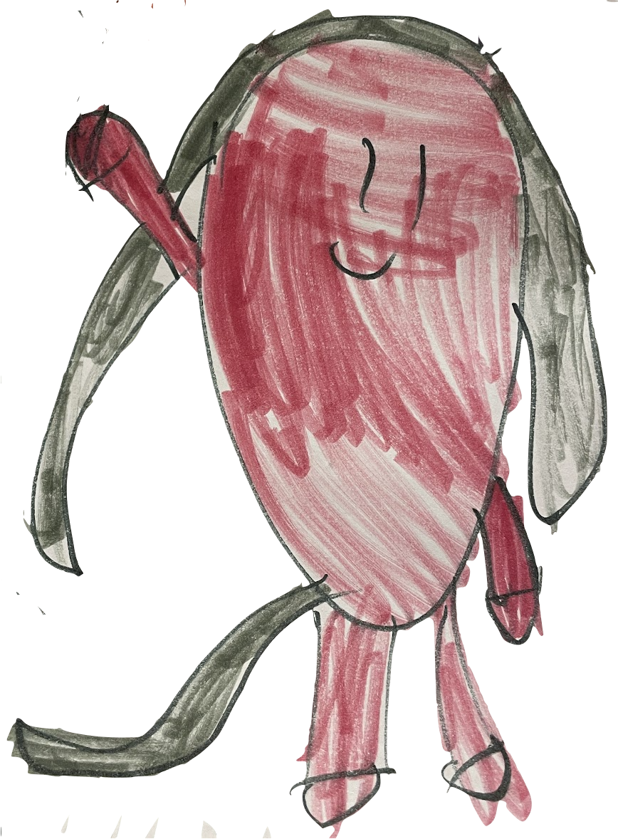
Collaborating with Dalle3 [1/6]

Slide 11
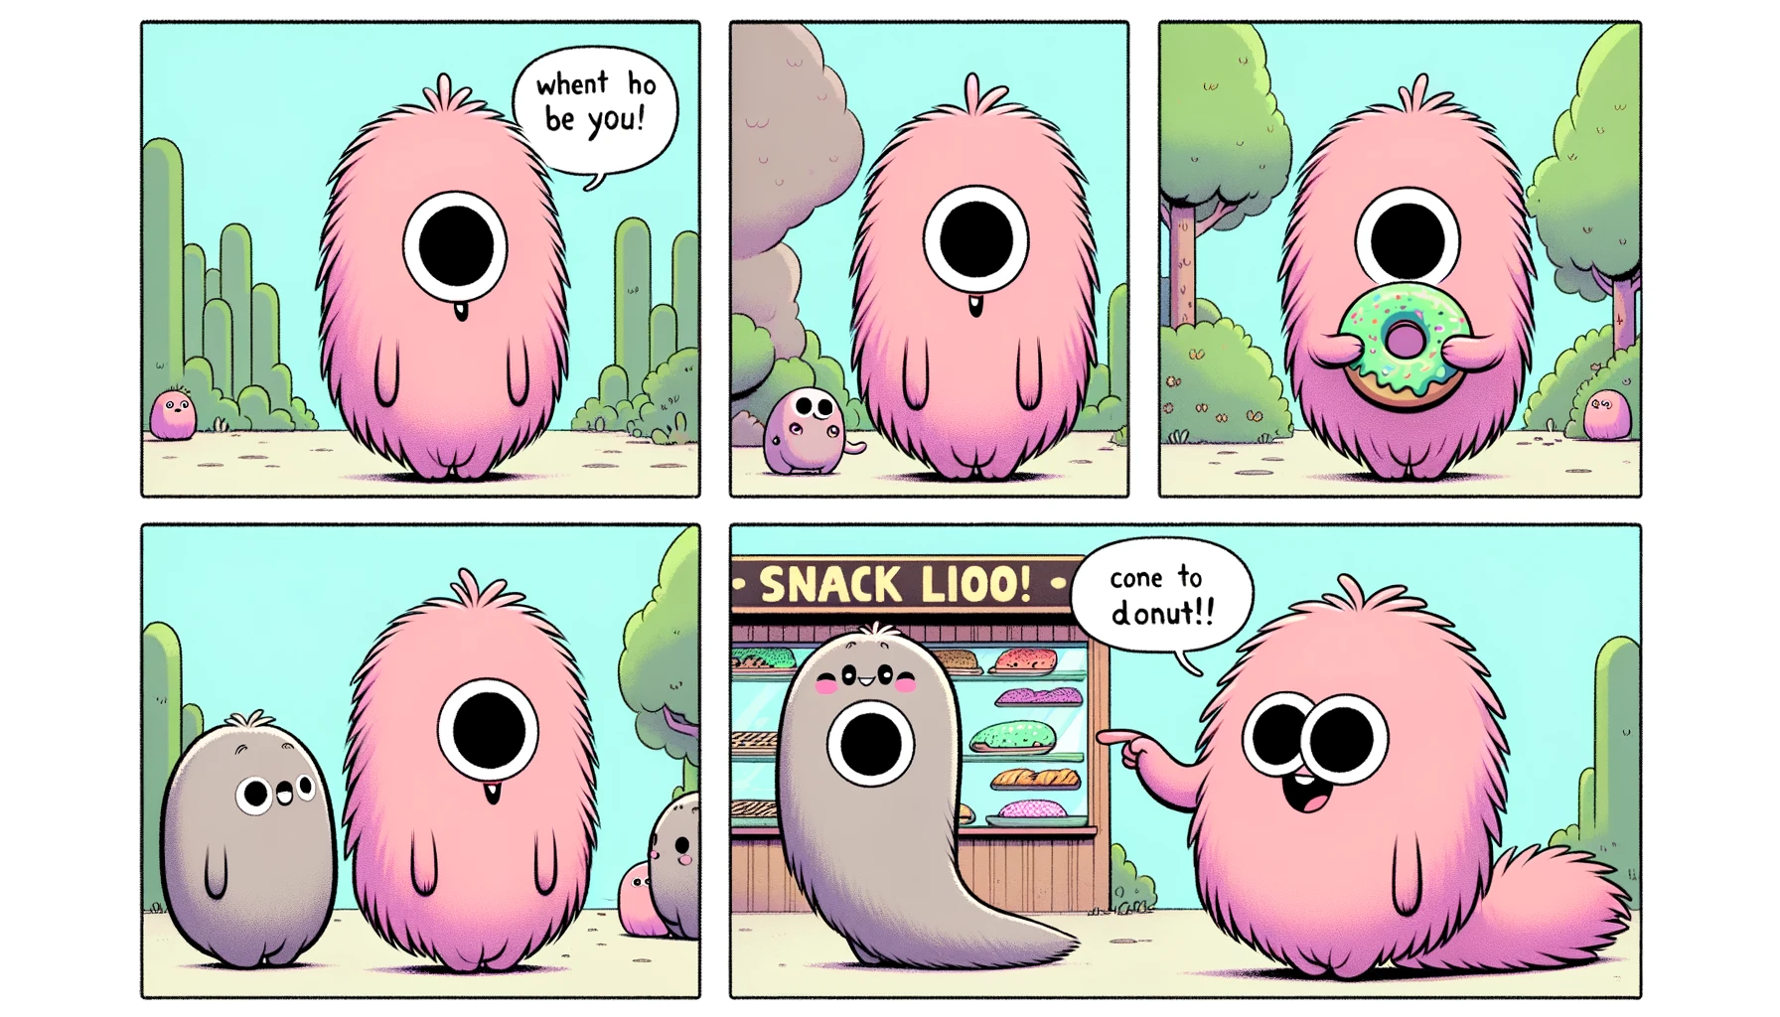
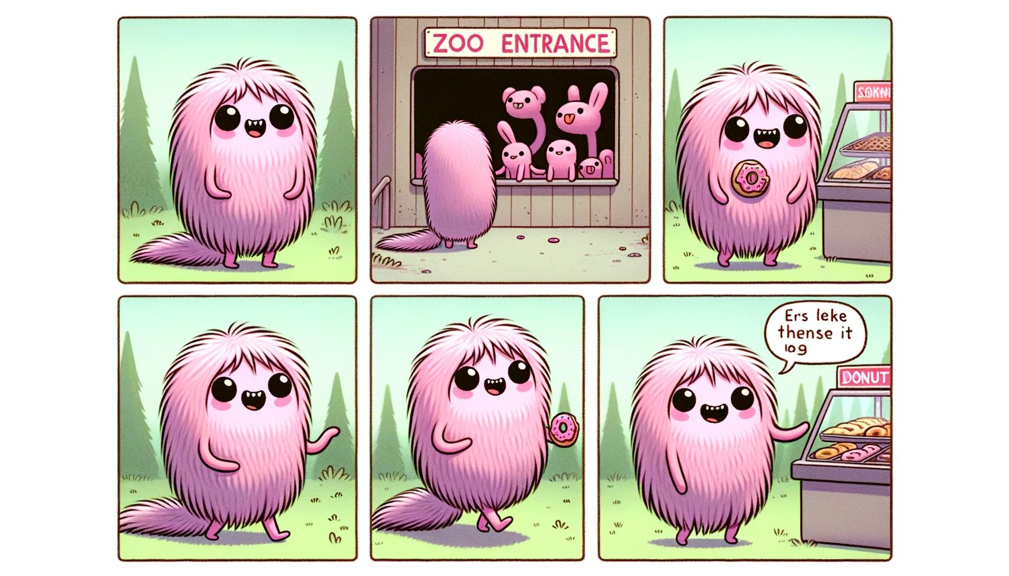
Collaborating with Dalle3 [2/6]
Notes:
Figure: Dalle’s second image creation from a more detailed “Namba prompt” without hand drawing

Slide 12
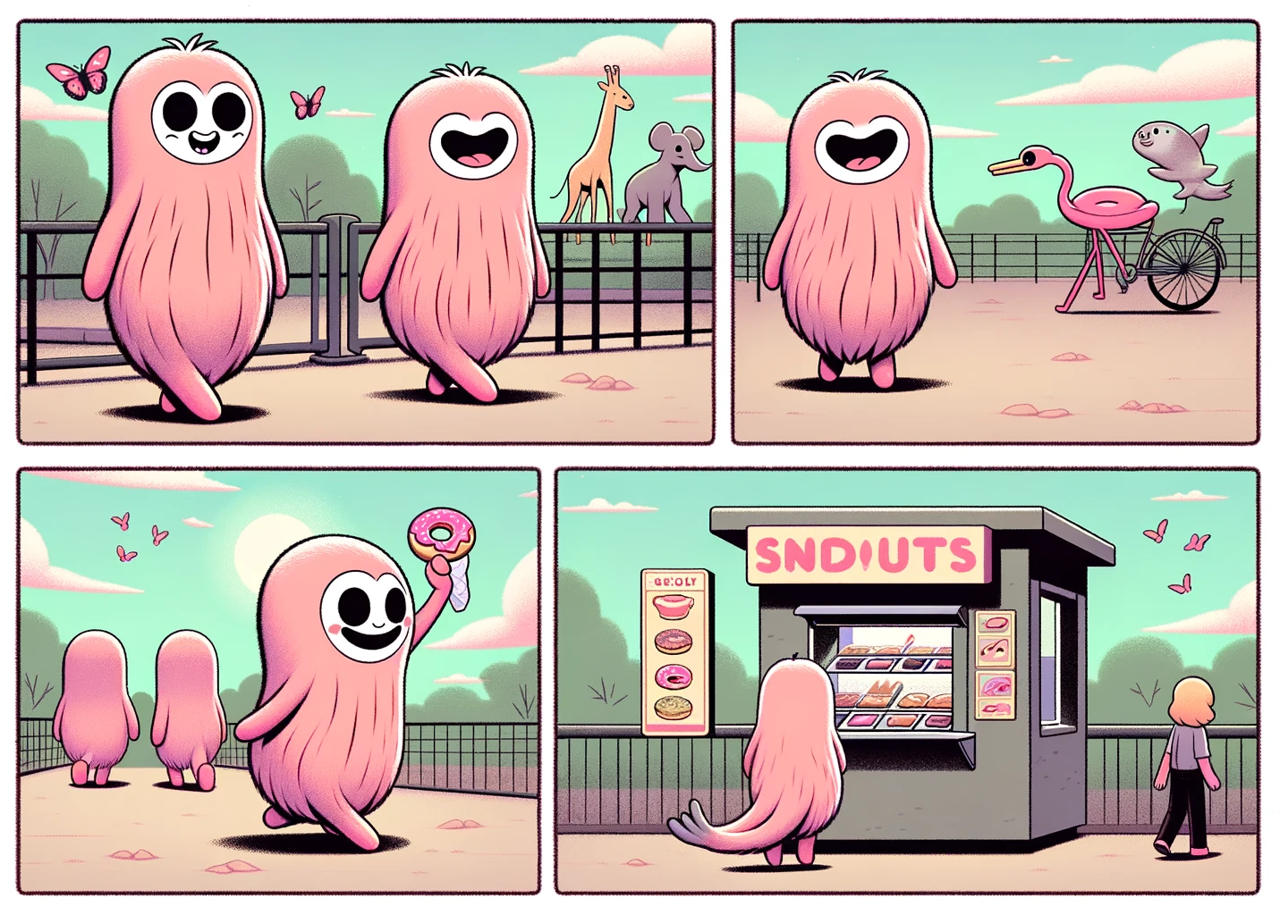
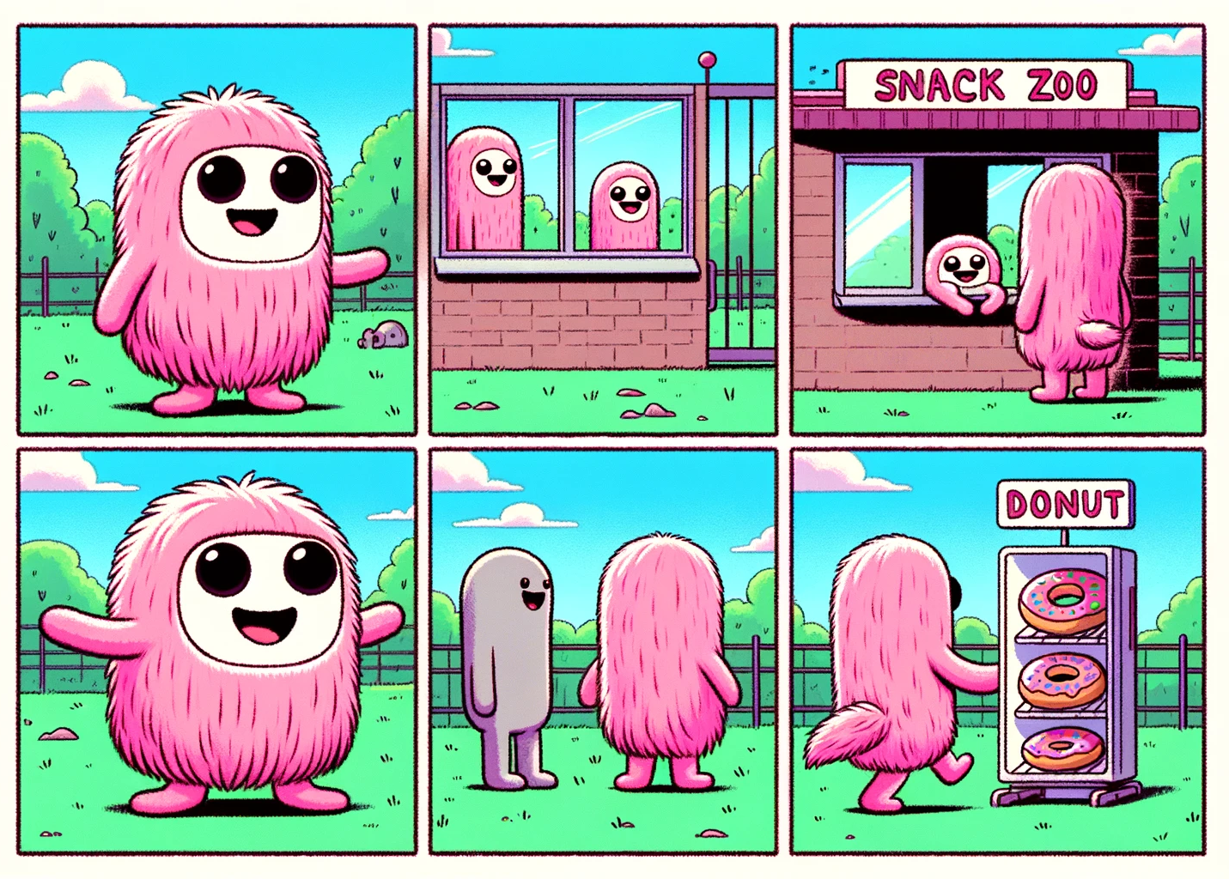
Collaborating with Dalle3 [3/6]
Notes:
Figure: Dalle’s third image creation from detailed “Namba prompt” with hand drawing

Slide 13
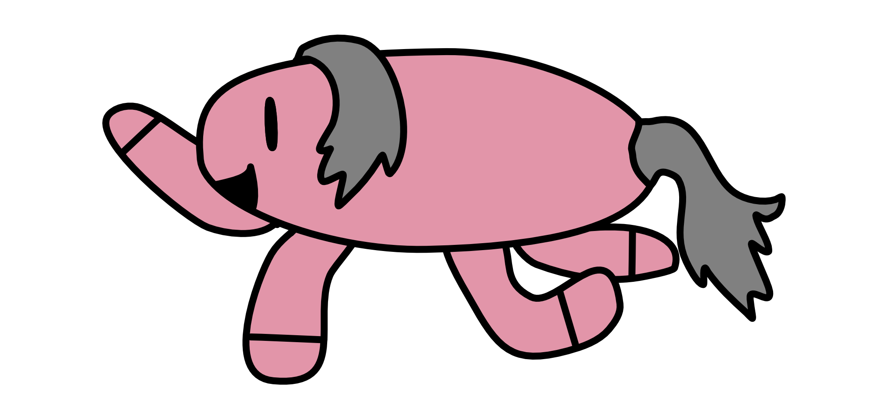
Collaborating with Dalle3 [4/6]
Notes:
Figure: a digital drawing of Vera’s imaginary friend “Namba”

Slide 14
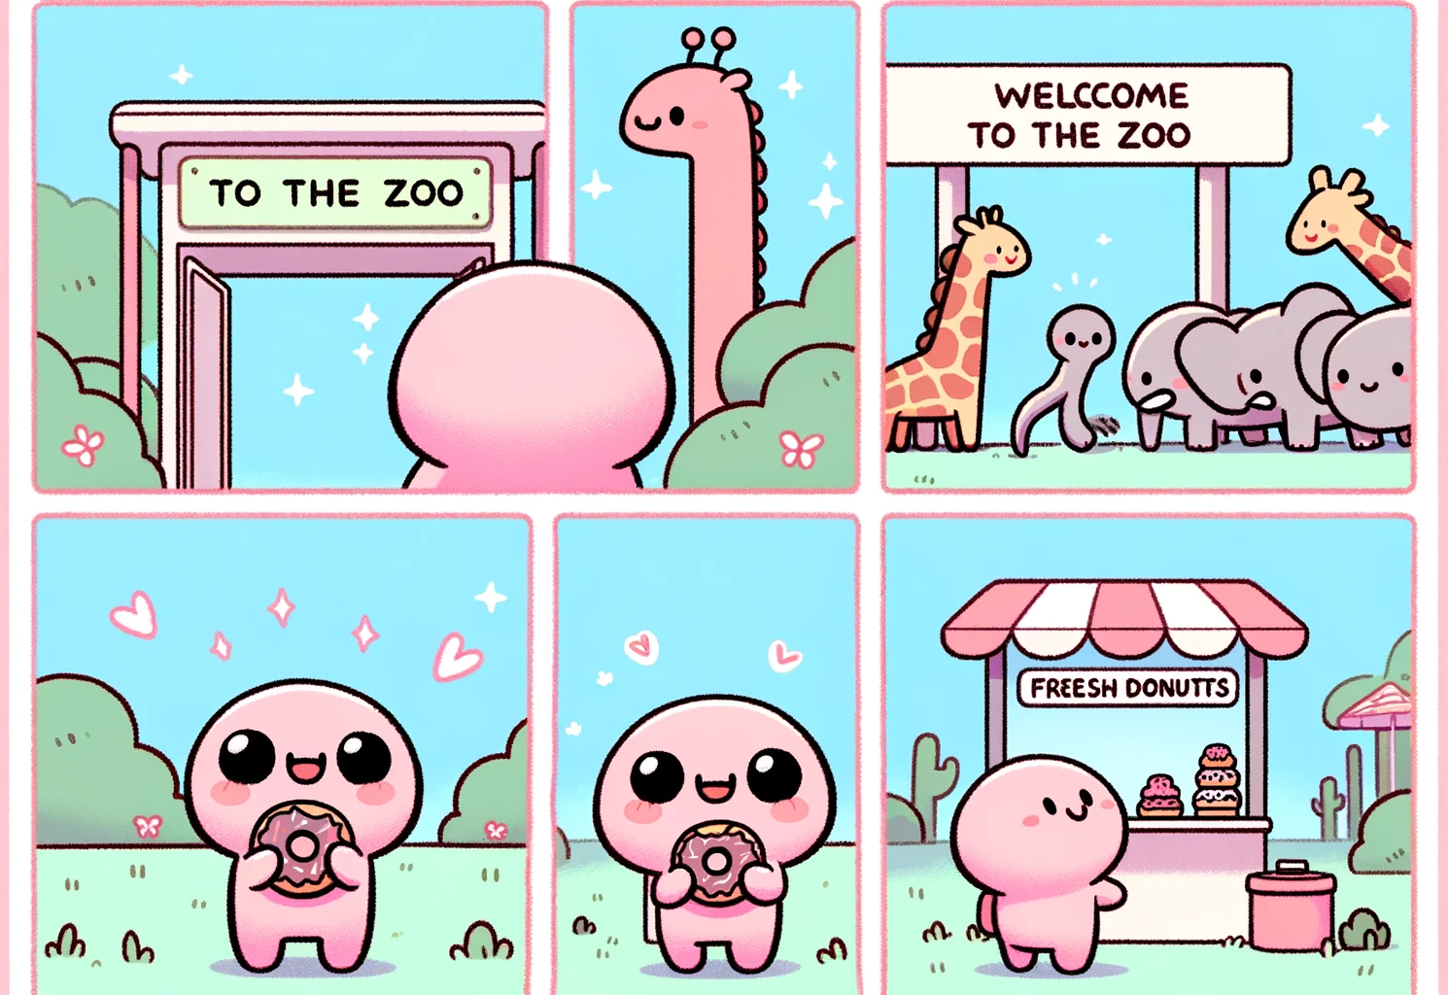
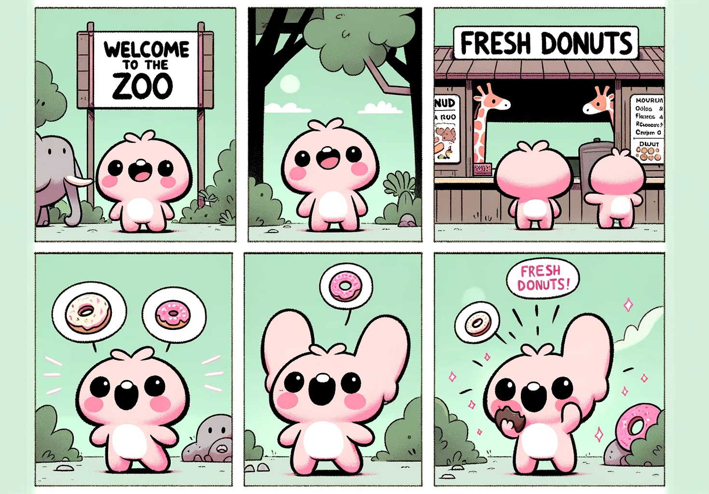
Collaborating with Dalle3 [5/6]
Notes:
Figure: Dalle’s fourth image creation from detailed “Namba prompt” with a digital drawing

Slide 15
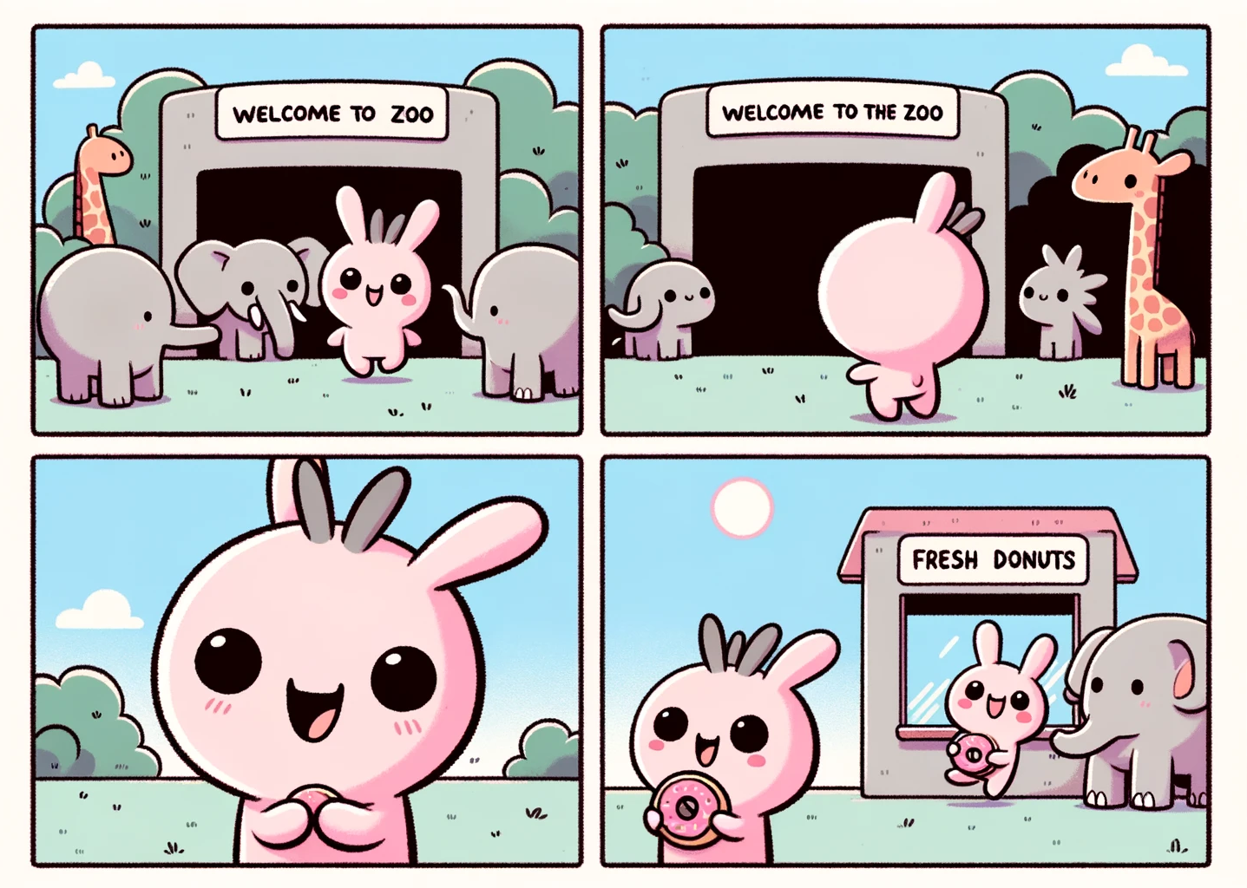
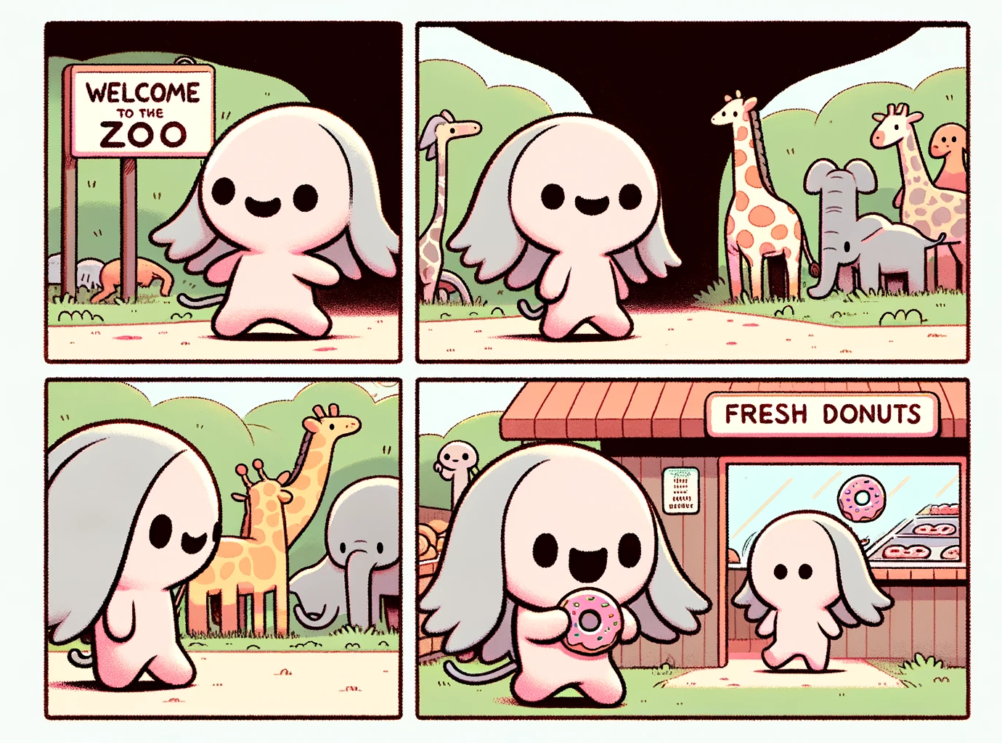
Collaborating with Dalle3 [6/6]
Notes:
Figure: Dalle’s fifth image creation from detailed “Namba prompt”, digital drawing, and correction

Slide 16
Takeaway

Slide 17
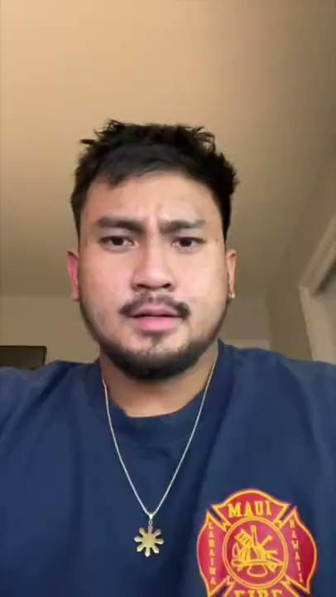
HeyGen AI Language Tool??

Slide 18
Takeaway

Slide 19
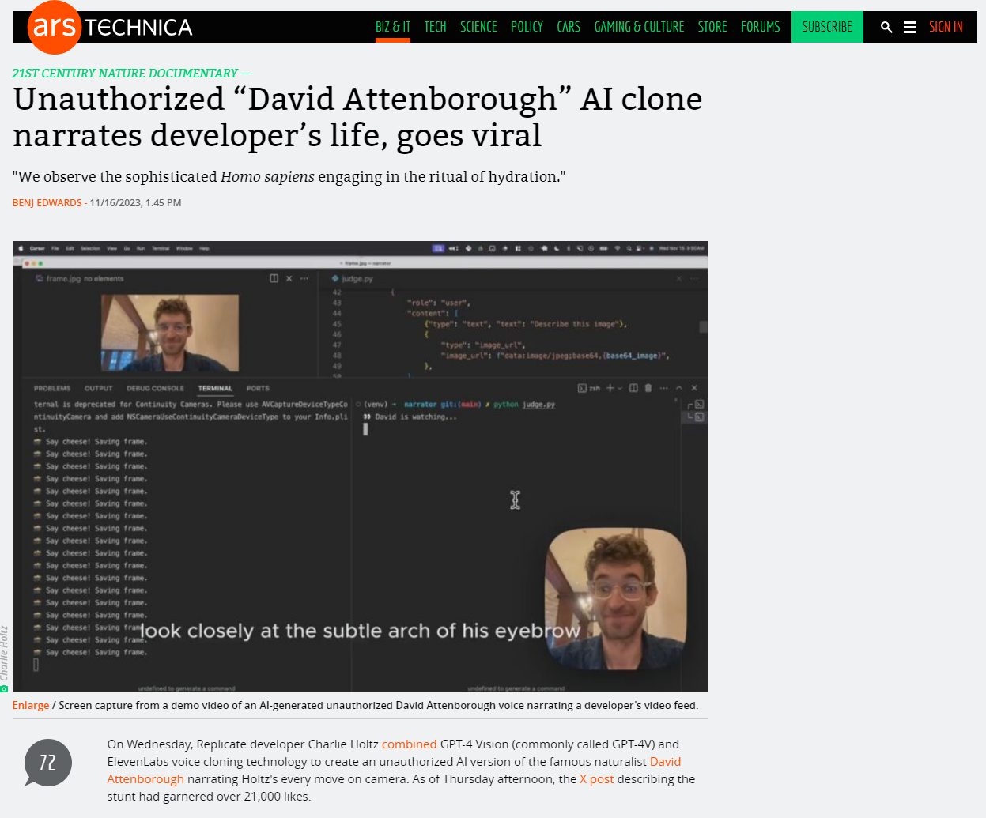
Ethically Ambiguous Narrator…
https://arstechnica.com/information-technology/2023/11/unauthorized-david-attenborough-ai-clone-narrates-developers-life-goes-viral/

Slide 20
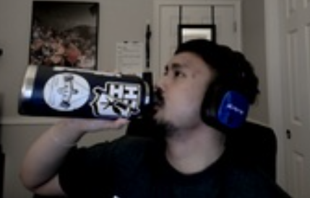

Ethically Ambiguous Narrator…
Here we observe a magnificent specimen of Homo sapiens in its natural habitat, the home office. This cunning creature has ingeniously adapted to its environment, hydrating with a device imprinted with mysterious symbols. Witness the concentration, the dexterity, as it tips the vessel, a ritual vital to its survival. Astonishing!
https://github.com/Iwasson/narrator

Slide 21
Takeaway

Slide 22
Open Ethical Questions
Is providing an input image sufficient for claiming authorship on AI generated images?
Who should be held responsible for AI translation mistakes/errors?
What are the implications for using human voices to narrate video/images?

